Slide 1
Data Storage
The primary database will be a mongodb database hosted on the AWS server. A secondary database will exist on the Rasberry Pi. This will contain enough data to be able to operate the pill box for a period of time if the connection to the server fails.

Slide 2
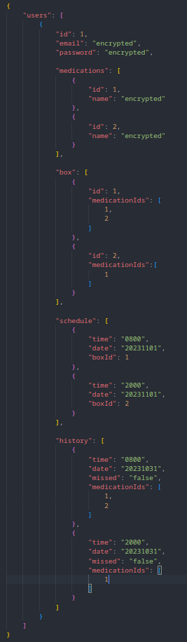
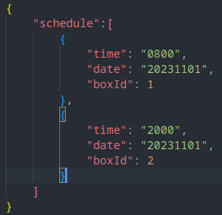
Data Storage – Example Entries
User Entry on server
Schedule stored on Rasberry Pi

Slide 3
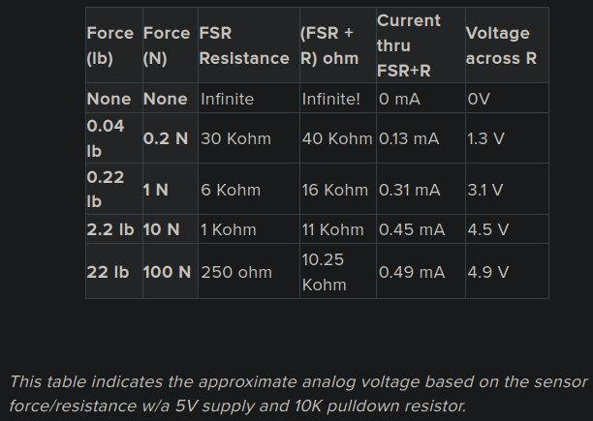
Data Gathering - Switches
Force Sensitive Resistor
- Analog data
- Values between 0mV – 5000mV
- 0mV reprensents no force
- 5000mV represents a high force
- This will tell us if a box is empty or has pills inside
Micro Switch
- 0v across a switch when the circuit is not completed
- 5v across a switch when the circuit is completed.
- This will tell us if a box is open or closed

Slide 4
Data Gathering - User
User Data
- User email
- Password
- This will be used to create a user account
Medication
- Medication details
- This will be used to assist in refilling the boxes and to create medication histories
Time
- To send notifications
- To see when a box was opened
- To record missed doeses

Slide 5
Data Processing
Sensor data will be processed locally.
Notifications and medication history will be process on the AWS server.
Notifications will be sent to the users’ devices by AWS server.
Medication data will be edited on the web client before being sent to AWS server.
The data will be processed to record if medication was taken on time, a dose was missed and if the medication box will require a refill.
A CRON job will be running to restart the program if it has stopped.

Slide 6



Data Processing – Example Queries
Find all entries where the user has missed a dose.
Get the 30 most recent histroy entries.
Get the next 5 entries in the users schedule.

Slide 7
Data Security
Data will be transferred between the device, server and web/mobile client by HTTPS.
HTTP GET will only be used to retrieved data.
HTTP POST or PUT will be used to enter or update data.
Sensitive data, such as medication information, will only be stored as encrypted data.
End to end encryption will be used to ensure only the user as access to sensitive data in a decrypted form.
The database will be stored on a AWS server.
Only times to take medication and which specific box it is stored in will be stored locally.
If sensor data is required to be stored locally due to an inability to communicate with the server, it will be wiped after the connection is reestablished and the updates are applied.

